Slide 1
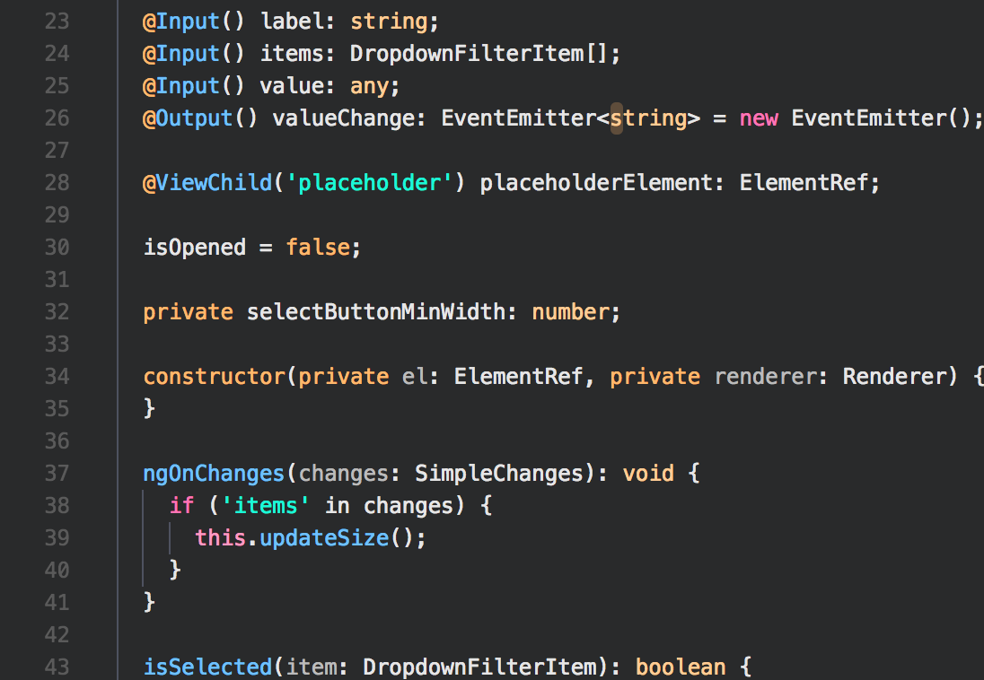

Web-App
Fullstack Challenge
Geneva, 08.08.2019
CONFIDENTIAL AND PROPRIETARY Any use of this material without specific permission of
Open Web Technology is strictly prohibited

Slide 2

Web-App FullSTACK
Challenge
Create the „Boat App“. It’s a simple app, where a user can get a quick overview over list of boats ...
The following use cases should be implemented:
UC1
The user opens your app and gets a login screen. He has to login. After a successful login he is navigated to the overview page (UC2).
UC2
The user has a list of all boat resources
UC3
The user can add or update or delete boat
UC4
The user clicks on a boat item and gets a detail view over it.
7/20/2023
4

Slide 3
Web-App FullSTACK
Challenge
The back-end is RESTFUL api with specific requirements :
REQ1
Create an CRUD endpoint for managing boat. A boat should have at least the following attributes and appropriate validation:
Name
Description
REQ2 (optional)
Implement the following security aspects.
Authentication / Authorization (only authenticated user can access to the resources )
7/20/2023
4

Slide 4
Web-App FullSTACK
Challenge
Use one of the listed Stack / CLI / Boilerplate :
Front-end CLI / Boilerplate
CLI / Boilerplate | URL
Angular CLI | https://cli.angular.io/
Vue.js CLI | https://vuejs.org/v2/guide/installation.html#CLI
React CLI | https://github.com/facebook/create-react-app
Back-end CLI / Boilerplate
CLI / Boilerplate | URL
Java / Spring Boot | https://spring.io/projects/spring-boot
.NET Core Web API | https://github.com/dotnet/core
Ruby | https://www.ruby-lang.org/en/
Drupal 8 | https://www.drupal.org/docs/8/api/restful-web-services-api
Php / Laravel | https://laravel.com
7/20/2023
4

Slide 5
Web-App FullSTACK
Challenge
Notes
Use Git and make your code available via GitHub or Bitbucket.
Use appropriate tools, libraries and frameworks to make your life easy.
7/20/2023
4

